Slide 1
Course Registration App
CSCI 3130 Group 12
Peter Chartier,
Bin He,
Mao Zheng,
Xiaoze Xia,
Chasteen Redondo,
Jon MacDonald

Slide 2
Project Goal
Create an app that student can register for courses
7 user stories in Iteration 1
Login-in/out, check offered courses(Details), register courses, time conflict warning
8 User stories in Iteration 2
Professor profile, reset password, register new accounts, course searching, view tuition fee, check spots capacity
5 User stories in Iteration 3
Email notification, profile-picture changing, change available spots, UI Design, registered label

Slide 3
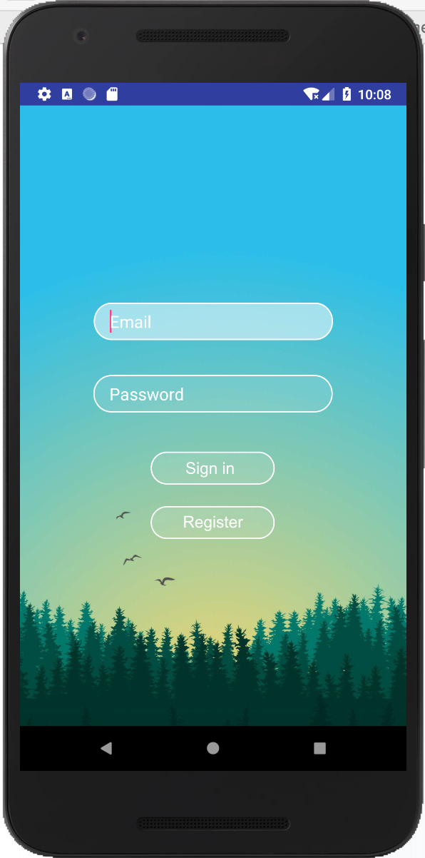
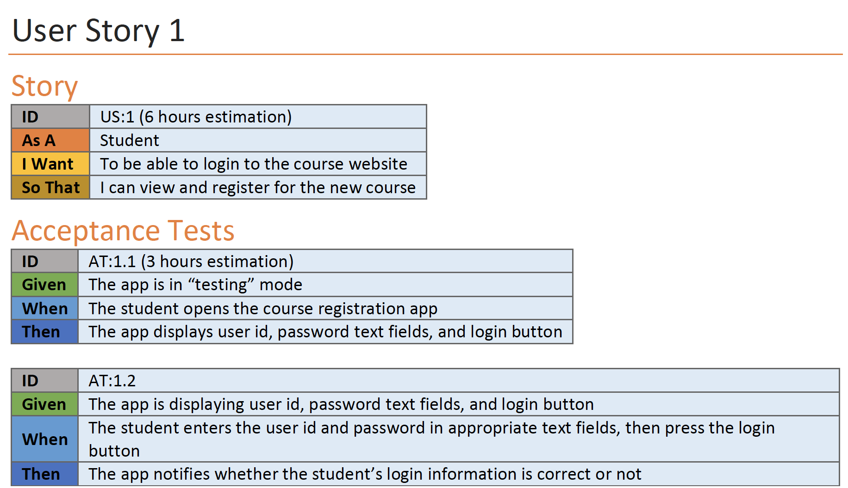

Sign-in and Register account

Slide 4
Check course detail

Slide 5
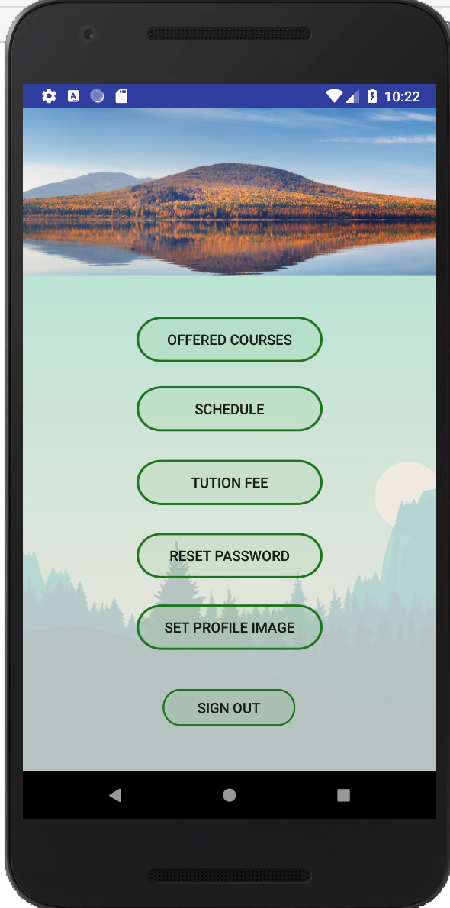
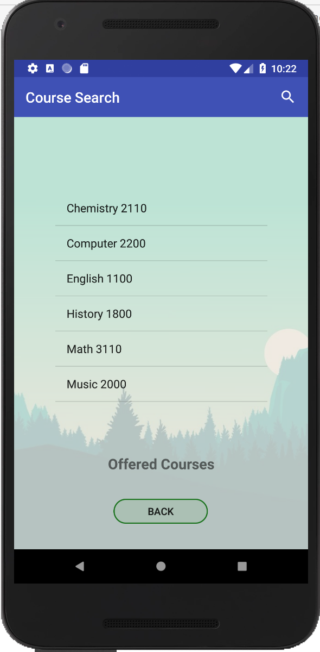
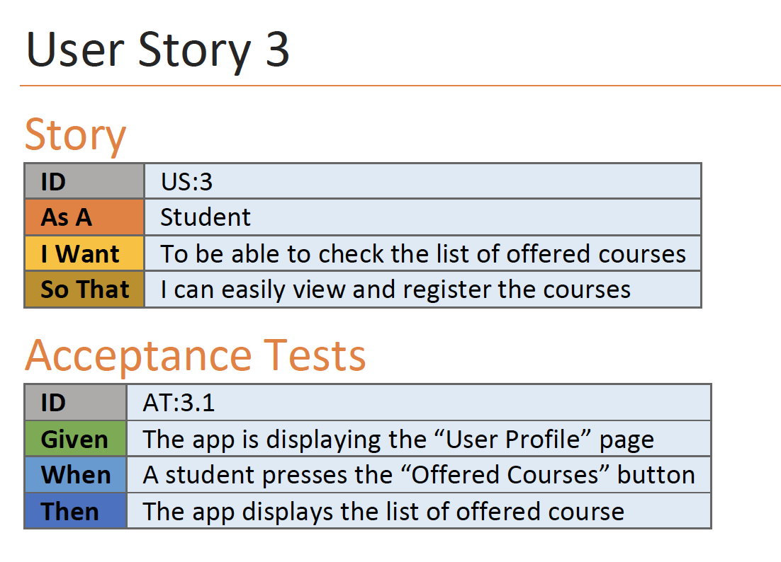
Check available courses information

Slide 6
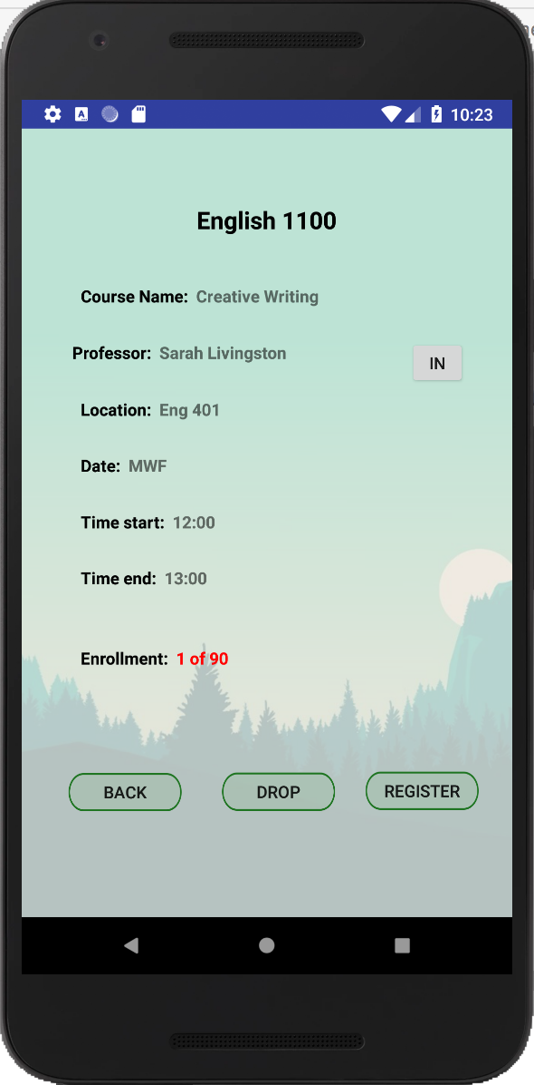
Check available courses information

Slide 7
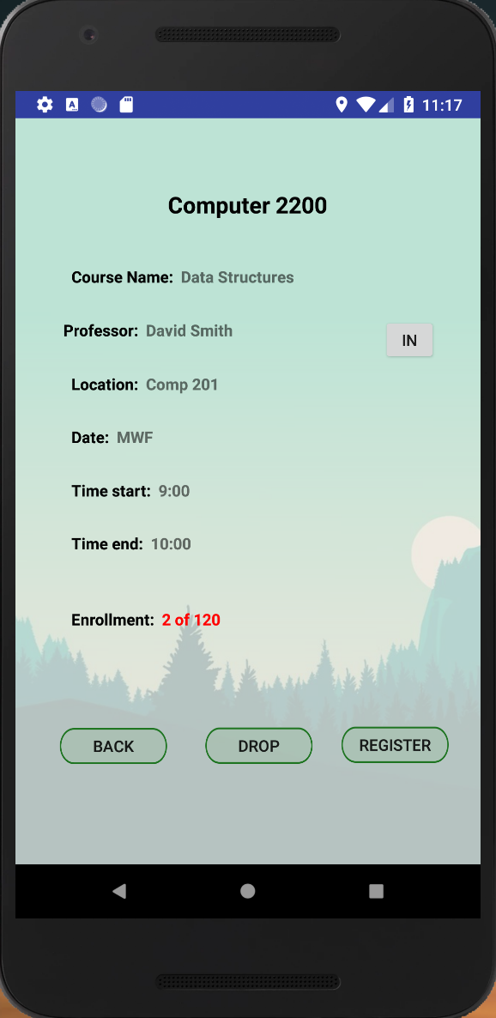
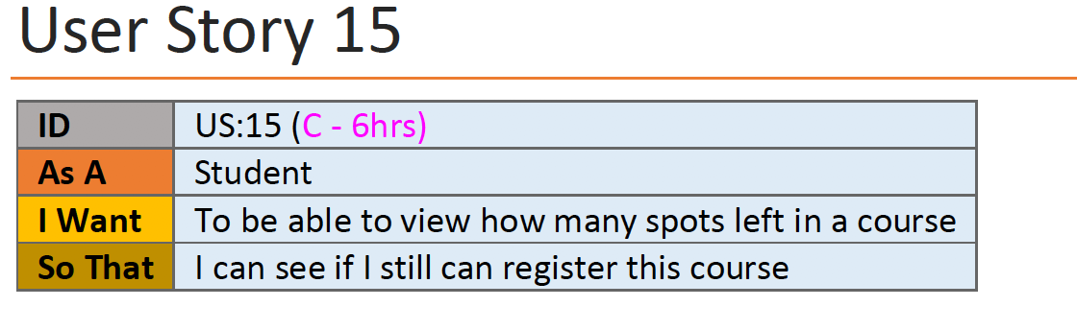
Check enrolment

Slide 8
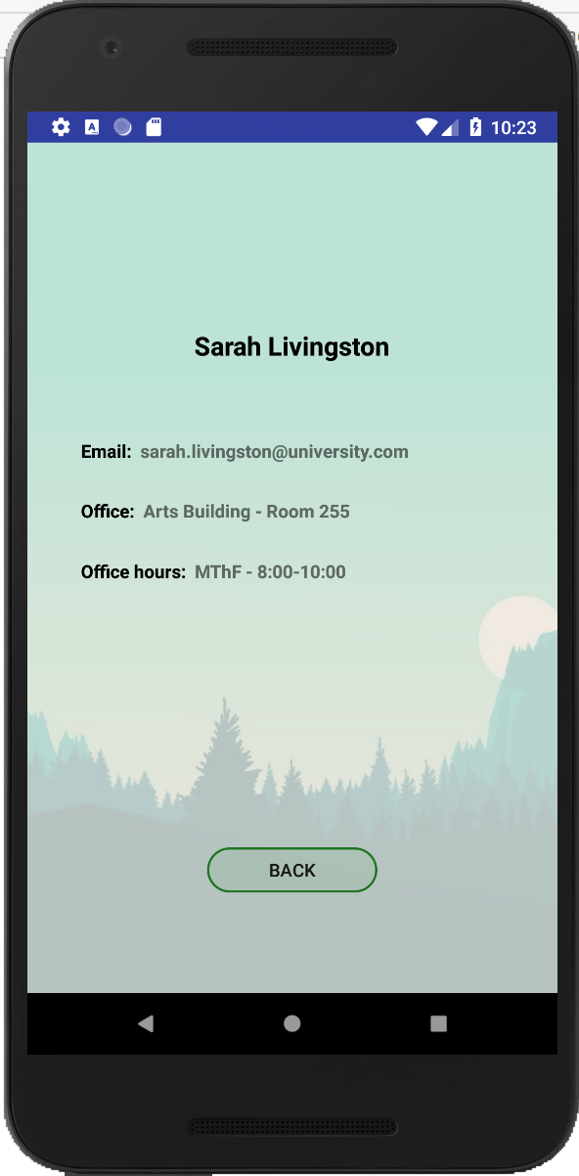
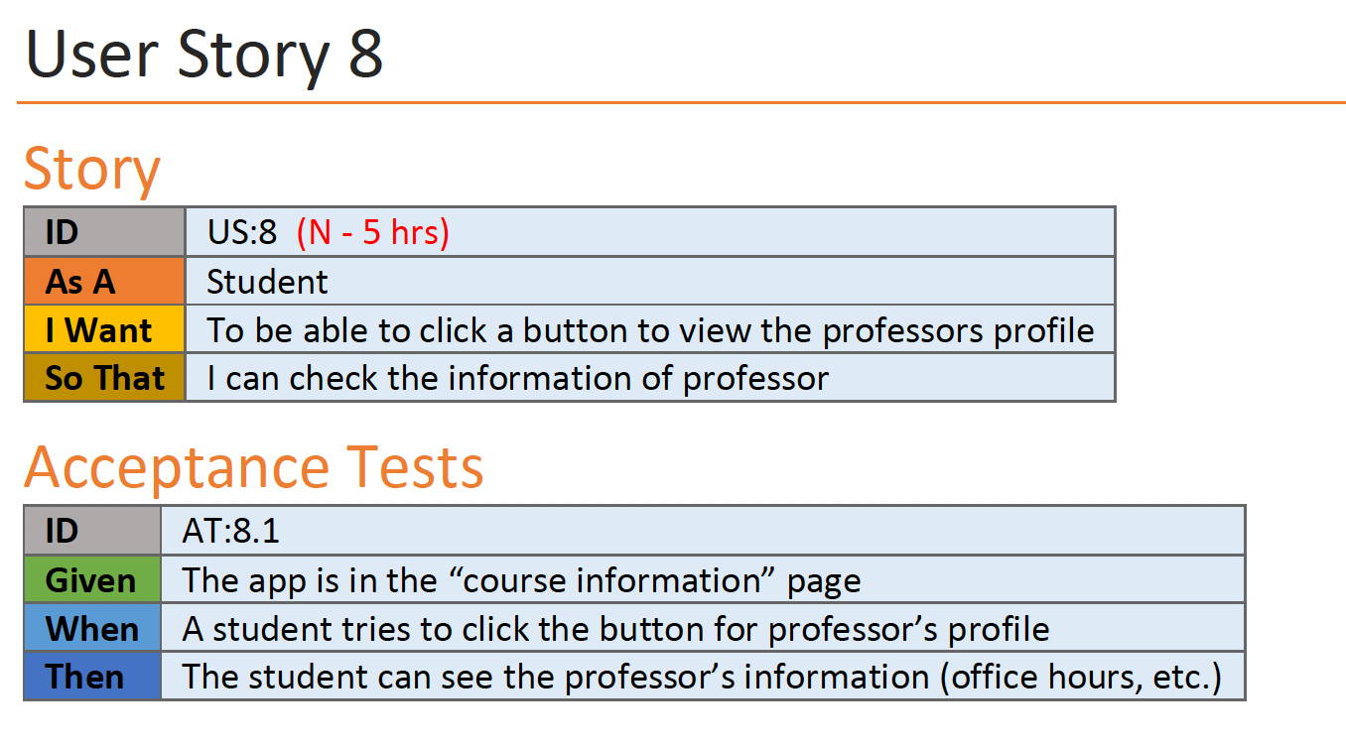
Check professor information

Slide 9
Check course schedule

Slide 10
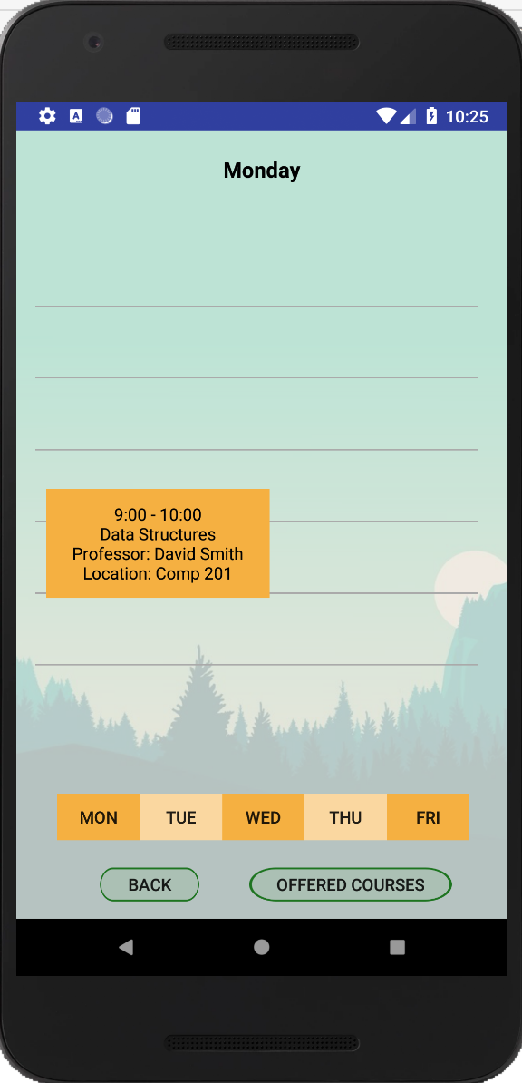
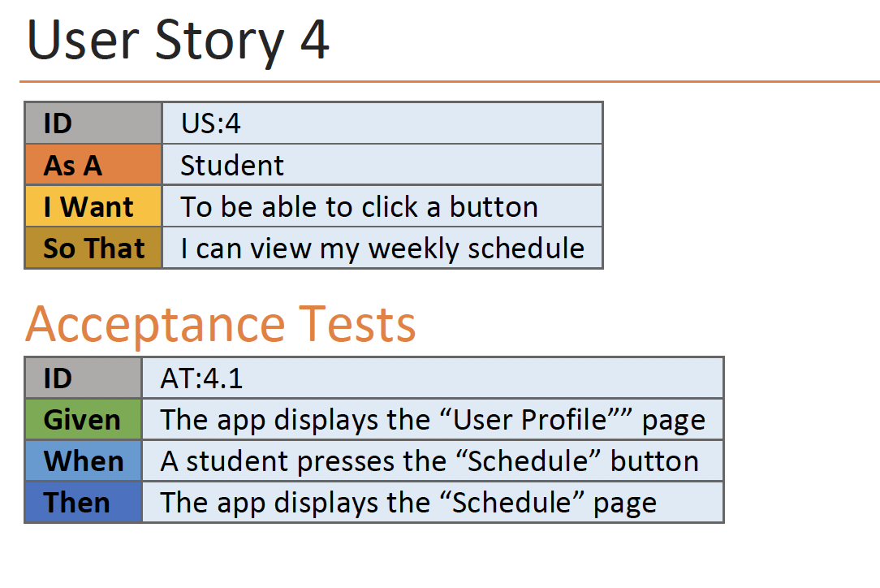
Day time schedule

Slide 11
Time conflict warning

Slide 12
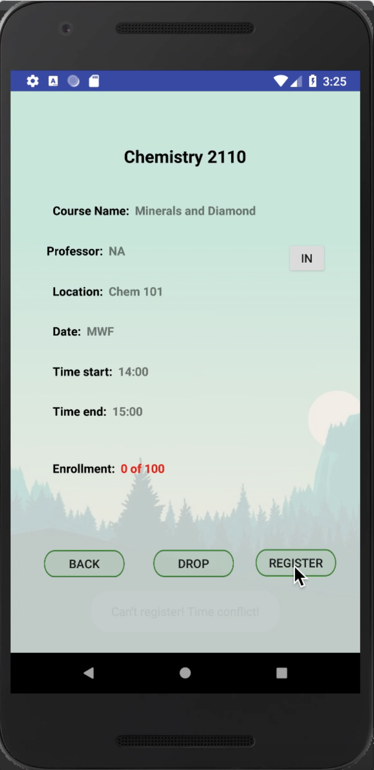
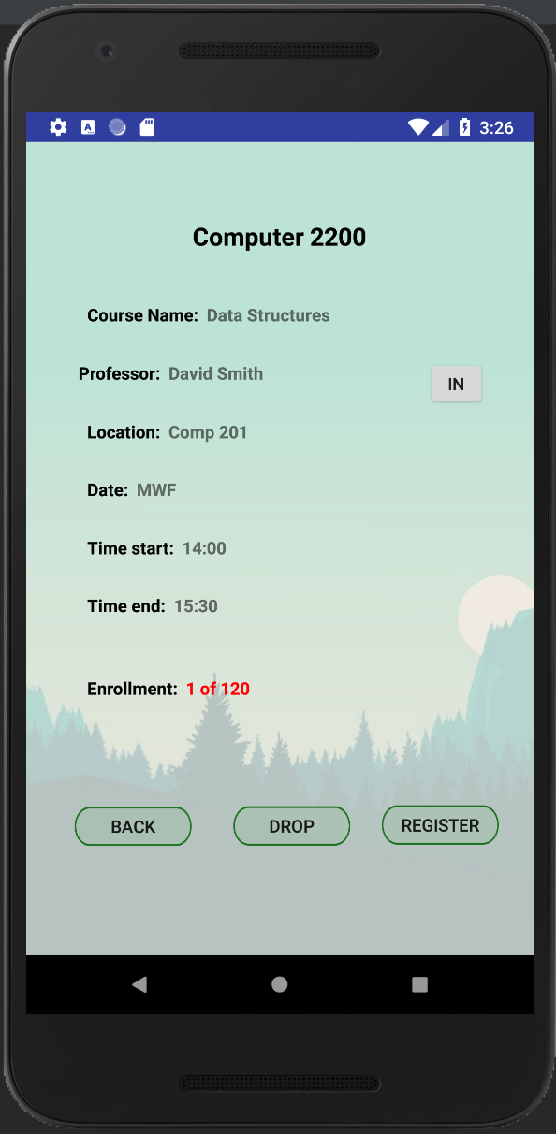
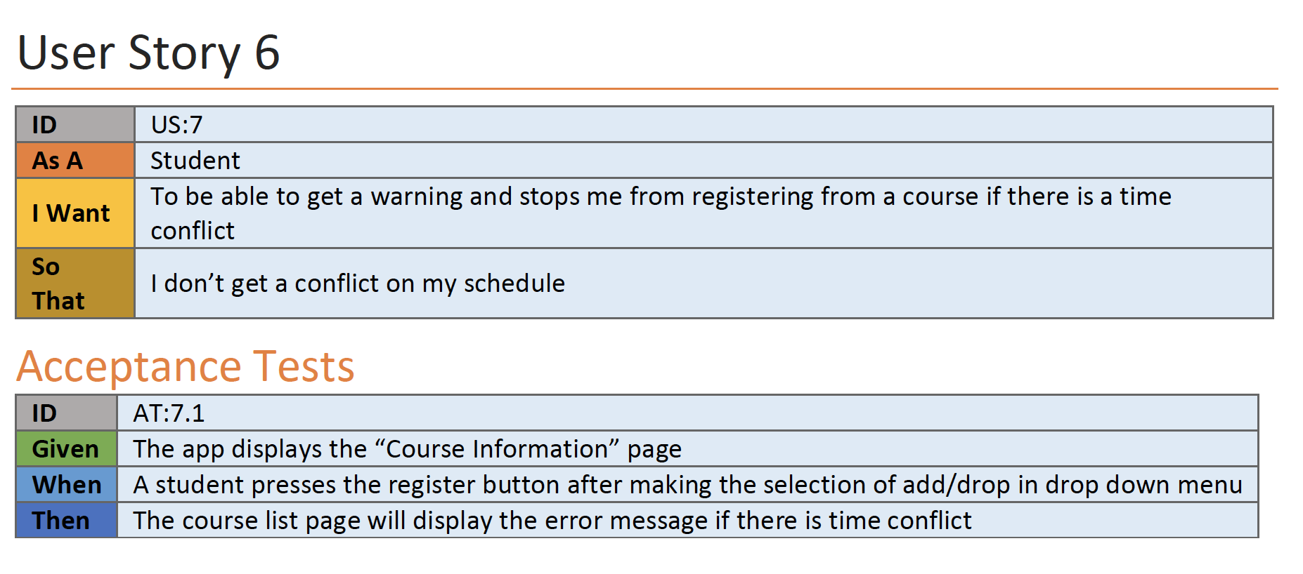
Time Conflict

Slide 13
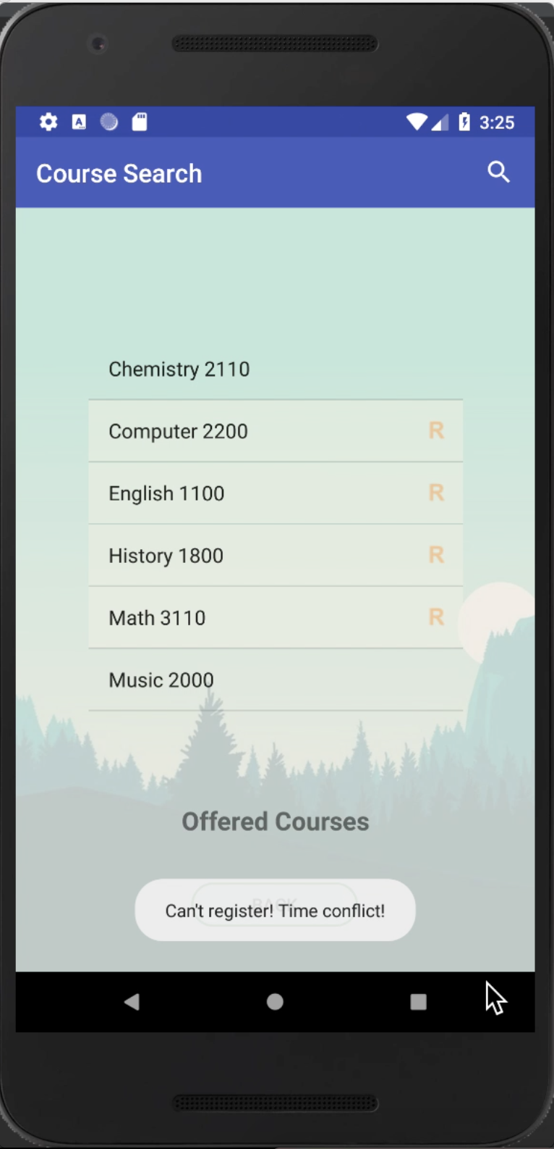
Time Conflict

Slide 14
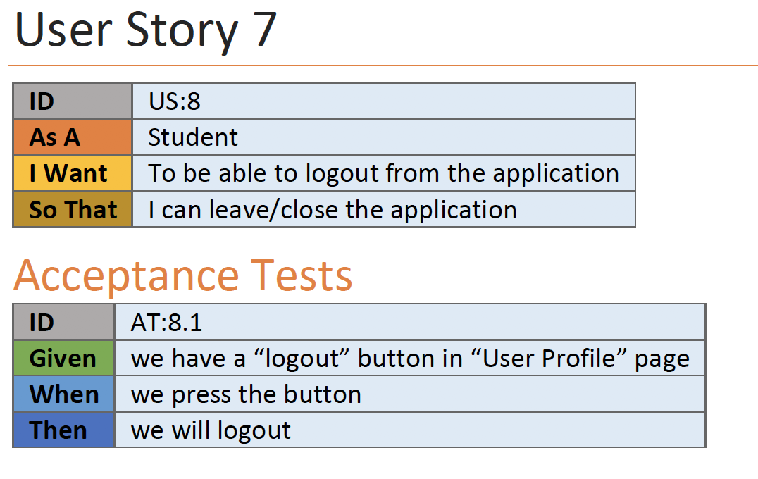
Log out from app

Slide 15
Additional functionalities

Slide 16
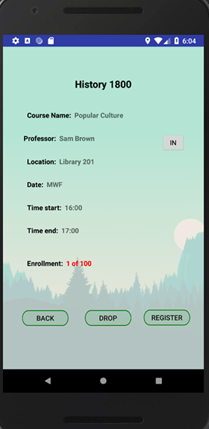

Email notification

Slide 17
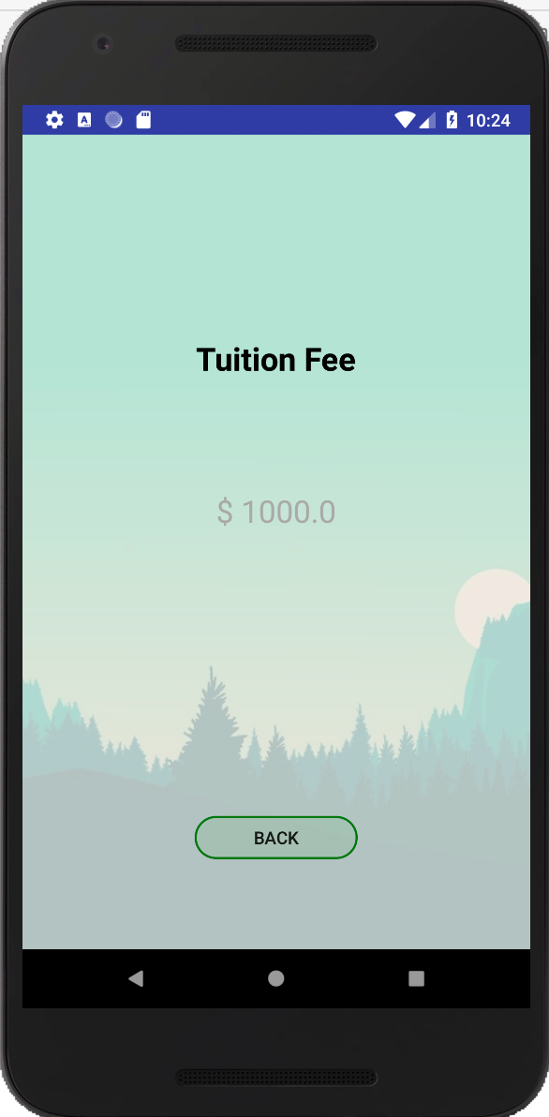
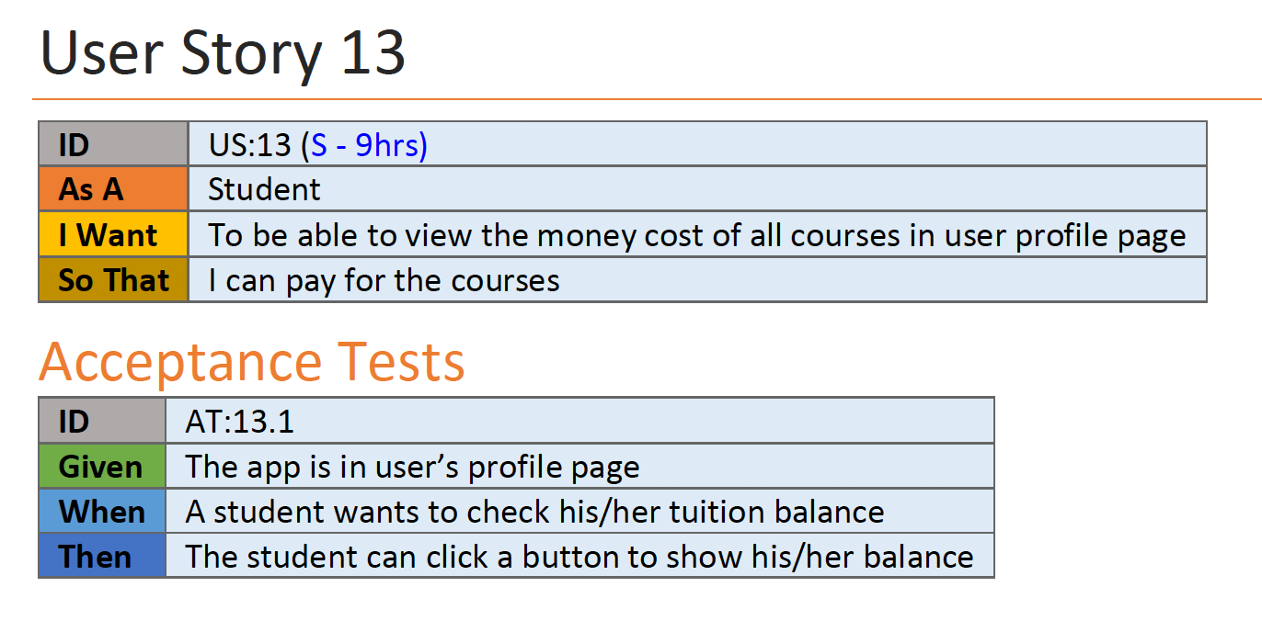
Check tuition fee

Slide 18
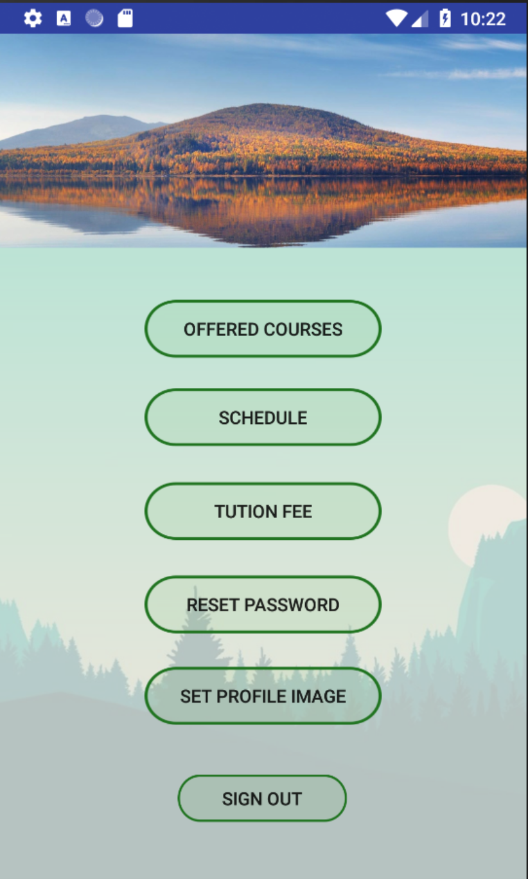
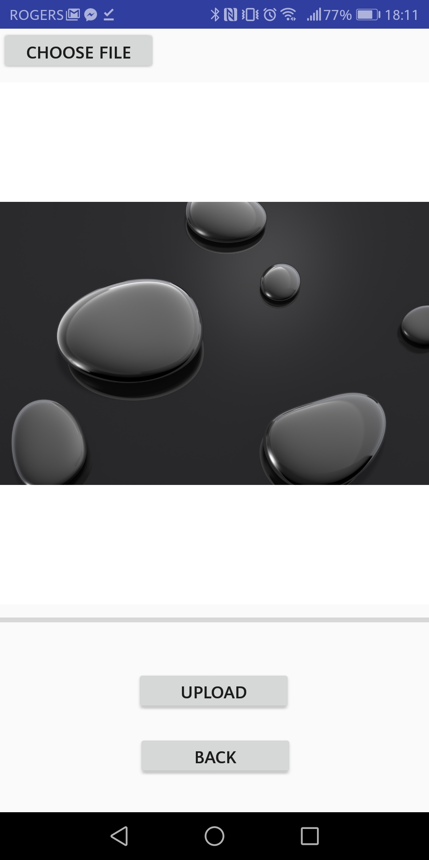
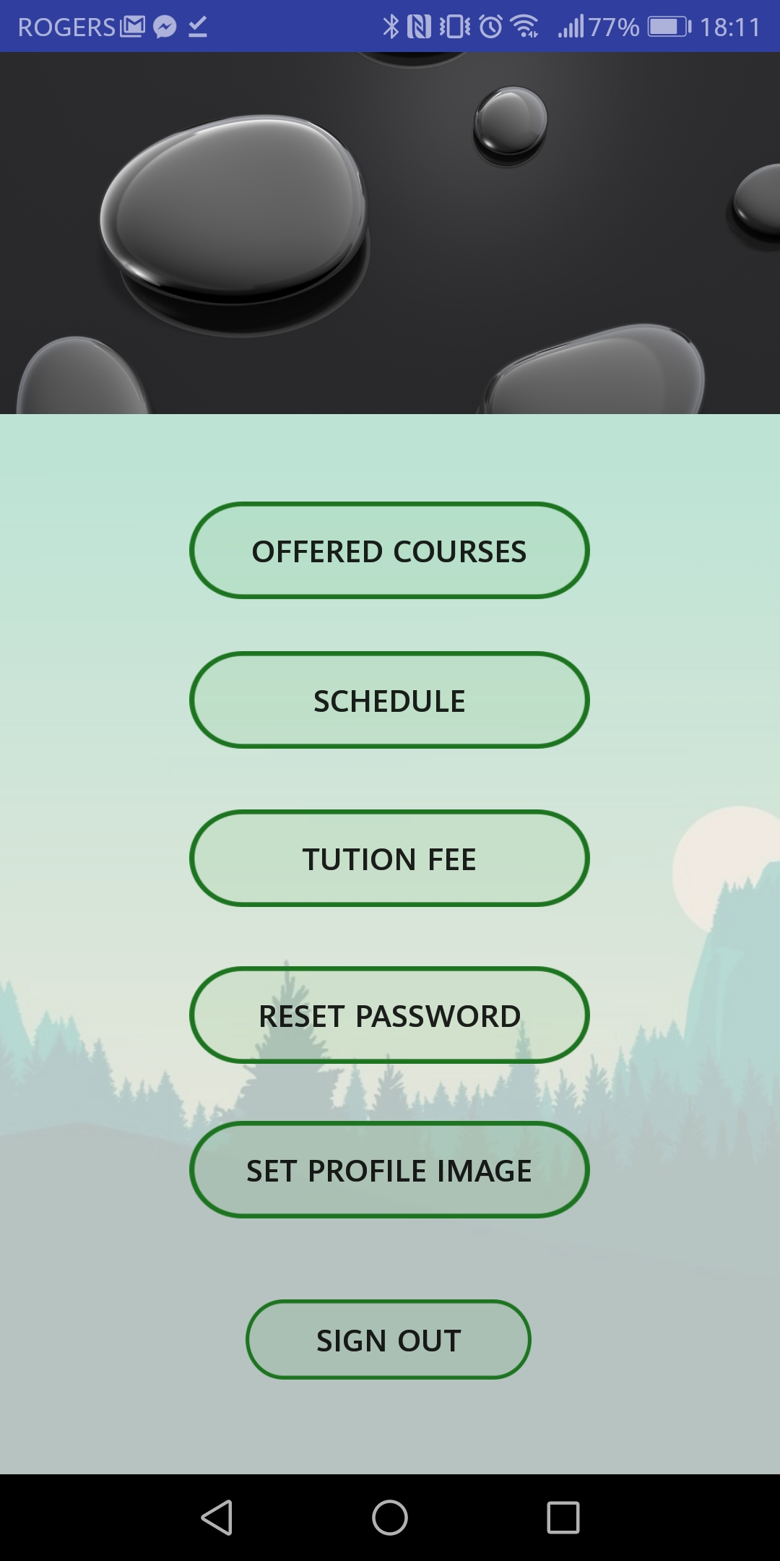
Set profile image

Slide 19
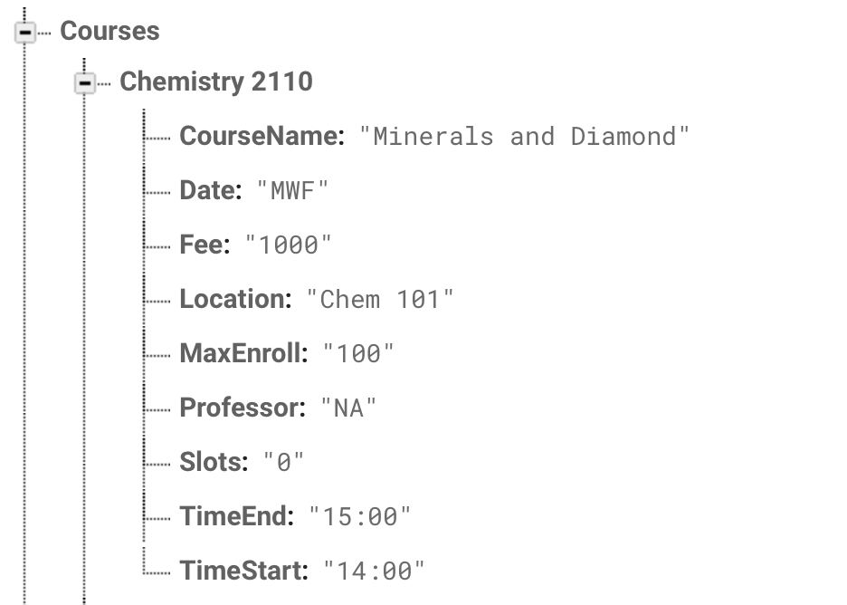
Successes and Challenges
Implementation:
Success: Time Conflict comparison
Time
TimeList
Time
Result list
No
No
No
Yes
.
.
.
Compare
Time (register a course)

Slide 20
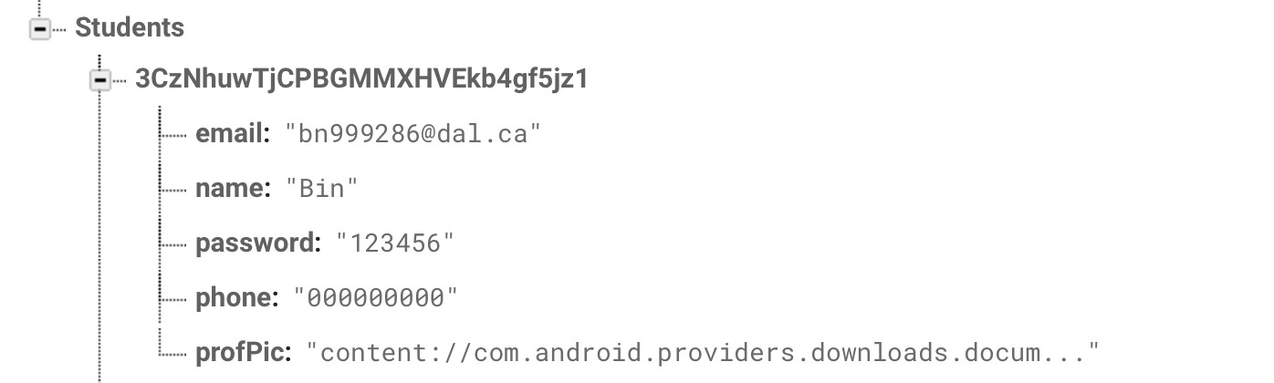
Successes and Challenges
Implementation:
Challenge: Profile image changing

Slide 21
Successes and Challenges
Software process:
Challenge：Lost a group member
Success: Finished all Functionality

Slide 22
Any questions?

